Slide 1

American International
University-Bangladesh
Physics-2 (Lab)
Presented By:
Group:06
Section: B

Slide 2
Name of the experiment:
To verify the laws of transverse vibration of strings and to determine the frequency of a tuning fork by Melde’s experiment.
2

Slide 3
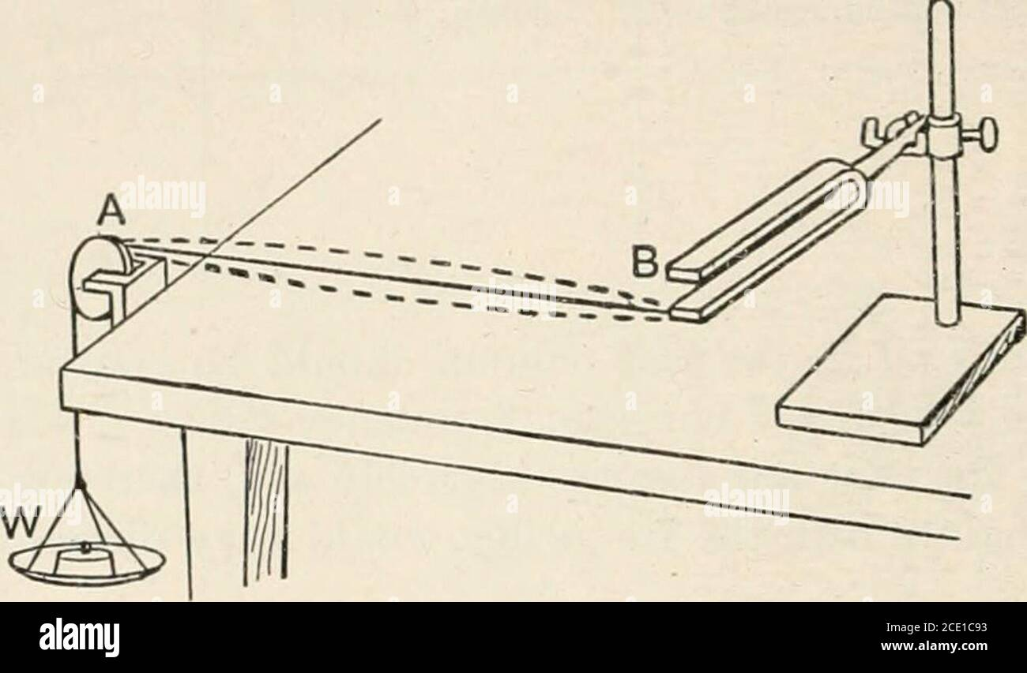

Let one end of B of the string be attached to one prong of the fork F. The other end A passes over a small pulley and is attached to a scale pan (Figure:1). The string will be set into vibration by setting the tuning fork into vibration. As a result, waves will proceed along the length of the string and will be reflected back on reaching the fixed end of the string. The superposition of the direct and reflected waves will form stationary waves, in which the extreme fixed ends of the string will always be nodes and in between them there may be one or more antinodes depending on the tension to which the string is subjected or the length of the string. Now by suitably adjusting the tension or the length, the frequency f of the fork may be made to equal to the frequency f of the fundamental or any one of the higher tones of the string. When this happens, a resonance is said to have occurred between the fork and the particular mode of vibration of the string. If the mode of vibration be assumed to be fundamental then the wavelength, λ= $2l,$ where l is the length of the string. The frequency of the fork will then be given by the relation,
Theory
Figure:1 – Arrangement of Melde’s apparatus.
3

Slide 4
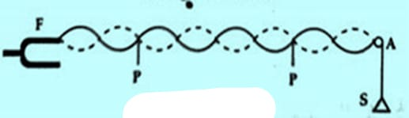


$f=f^{′}=\frac{1}{\text{λ}}$ =$\sqrt{\frac{τ}{μ}}=\frac{1}{2l}\sqrt{\frac{τ}{μ}}$ Where $μ$ is the mass per unit length of the vibrating string in grams and $τ$ is the tension applied to the string and is expressed in absolute units, i.e., dynes or pounds.,
Figure:2 – Transverse mode of vibration.
Now the motion of the prongs of the fork, which sets the string in resonant vibration, will be in a direction perpendicular to the length of the string i.e., transverse position (Figure:2) In the transverse case, the frequency f of the fork is the same as f’, the frequency of the string. Therefore, for transverse position, the frequency of the fork is $f=f^{′}=\frac{1}{2l}\sqrt{\frac{τ}{μ}}$ Where l is the length of a segment or loop between two consecutive nodes of the string. Thus, $f^{2}=\frac{1}{4l^{2}} \frac{τ}{μ}$ $\frac{τ}{l^{2}}$=4$μf^{2}$ = constant Thus by altering the tension $τ$ and hence the wavelength, the frequency of the tuning fork can be determined and also $\frac{τ}{l^{2}}$ = constant can be found which verifies the laws of transverse vibrations in a string.
4

Slide 5
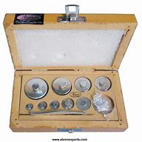
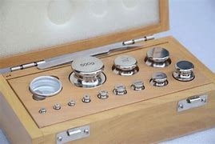

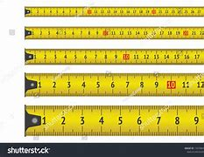
Apparatus
Melde's apparatus
String
Meter scale
Weight box etc..
5

Slide 6
Procedure: 1. We weighted the scale pan. The tuning fork was damped in a transverse position at one edge of the table. A pulley was fixed over a clamp and screwed at the other edge of the table. A thread was fastened to the top of the tuning fork prong passed over the pulley and the other end was connected to the scale pan. We hung small weights on the pan so that the string remained lightly stretched. 2. We rotated the screw of an electrically maintained tuning fork to excite it. This caused the tuning fork to vibrate and several nodes and loops were observed. 3. The weight was increased or decreased until the loops became maximum and the nodal points were fixed, indicating resonance. At this point the loops were of equal length and the mode of vibration of the string matched the frequency of the tuning fork. The length of the string was adjusted accordingly.
6

Slide 7
4. To determine the length between two successive nodes we placed two pins P,andP2 at
adjustable heights below the two extreme well defined nodes. This distance between the
pins was measured and the number of loops between them was counted. This operation
was repeated three times by independently adjusting the pin positions. From these observations, we calculated the length I of a segment.
5. The weight on the scale pan was increased by about 10 gm, so that the fixed ends changed.
Steps 2,3 and 4 were repeated to determine the new segment length. The number of loops were noted for each case. The length, l was calculated for each weight.
6. We determined the total length and weight of the string. By using these values, we calculated mass per unit length of the thread and mass of the scale pan.
7. At last we calculated the frequency of the tuning fork by using the relevant equations.
7

Slide 8

Observations and Calculations (A) Mass of the scale pan, w = 20 gm (B) Length of the string, L= 170 cm Mass of the string, M = 0.8 gm So the mass per unit of the thread, $μ=\frac{M}{L}=\frac{0.8}{170 }$ gm/cm $∴μ=0.005$ gm/cm
8

Slide 9
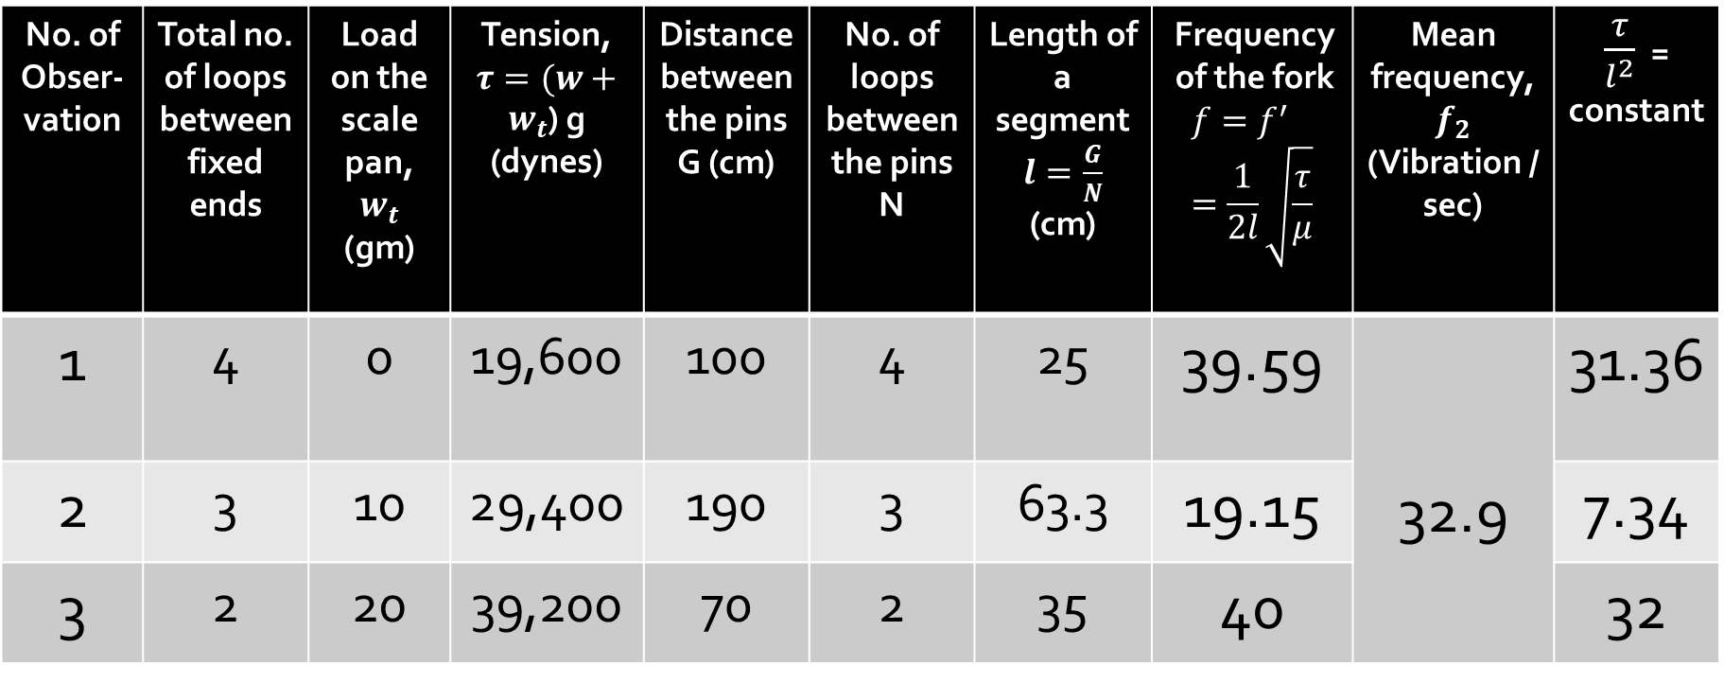
(C) Table for transverse position:
No. of Obser-vation | Total no. of loops between fixed ends | Load on the scale pan, $w_{t}$ (gm) | Tension, $τ=(w+w_{t}$) g (dynes) | Distance between the pins G (cm) | No. of loops between the pins N | Length of a segment $l=\frac{G}{N}$ (cm) | Frequency of the fork $$f=f^{′}=\frac{1}{2l}\sqrt{\frac{τ}{μ}}$$ | Mean frequency, $f_{2}$ (Vibration / sec) | $\frac{τ}{l^{2}}$ = constant
1 | 4 | 0 | 19,600 | 100 | 4 | 25 | 39.59 | 32.9 | 31.36
2 | 3 | 10 | 29,400 | 190 | 3 | 63.3 | 19.15 |  | 7.34
3 | 2 | 20 | 39,200 | 70 | 2 | 35 | 40 |  | 32
9

Slide 10


Results: The law of transverse vibration of string is verified by showing $\frac{τ}{l^{2}}$ = constant and the frequency of tuning fork is 32.9 Vibration/sec.
Discussions: The main objective of this experiment was to determine the frequency of an electrically maintained tuning fork using the transverse mode of vibration, demonstrated through Melde’s experiment.
The frequency, f was determined using the formula: ​​$f=f^{′}=\frac{1}{2l}\sqrt{\frac{τ}{μ}}$ Where: l is the length of one loop τ is the tension in the string,
$\text{M}\text{ass} \text{per} \text{unit} \text{of} \text{the} \text{thread}\text{,} μ =0.005$ gm/cm
10

Slide 11
We recorded the following frequencies based on different numbers of loops: For 4 loops: frequency = 39.59 Vibration/sec. For 3 loops: frequency = 19.15 Vibration/sec. For 2 loops: frequency = 40 Vibration/sec.
The frequency of the tuning fork was 32.9 Vibration/sec.
In this experiment some errors may occurred. Example: Human error. Inaccurate measurement of string length, incorrect calculation of wavelength, incorrect count of loops/antinodes, friction in pulley, neglecting mass of the string etc. can be the errors occurred.
Thus, Melde’s experiment is an effective and reliable method for studying the transverse vibrations of a string and determining the frequency of a vibrating source like a tuning fork.
11

Slide 12
Group:06
Thank You

